Slide 1

Grade 3
Review unit 1-4

Slide 2
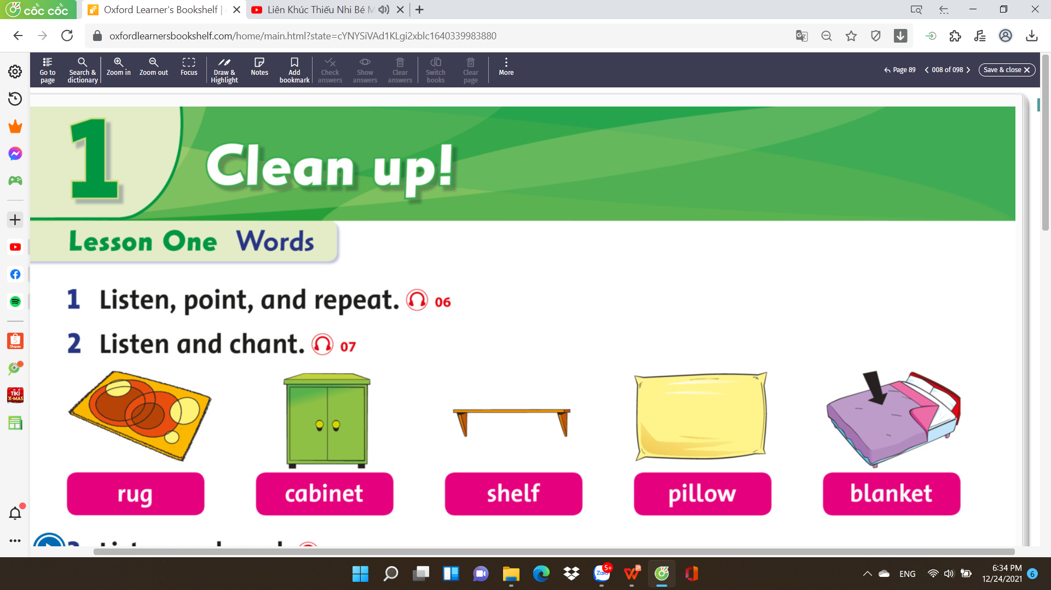

Slide 3
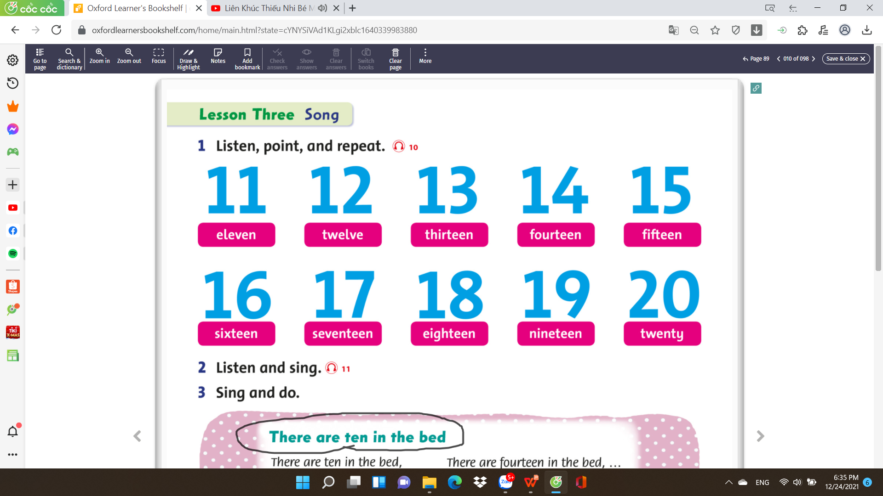

Slide 4
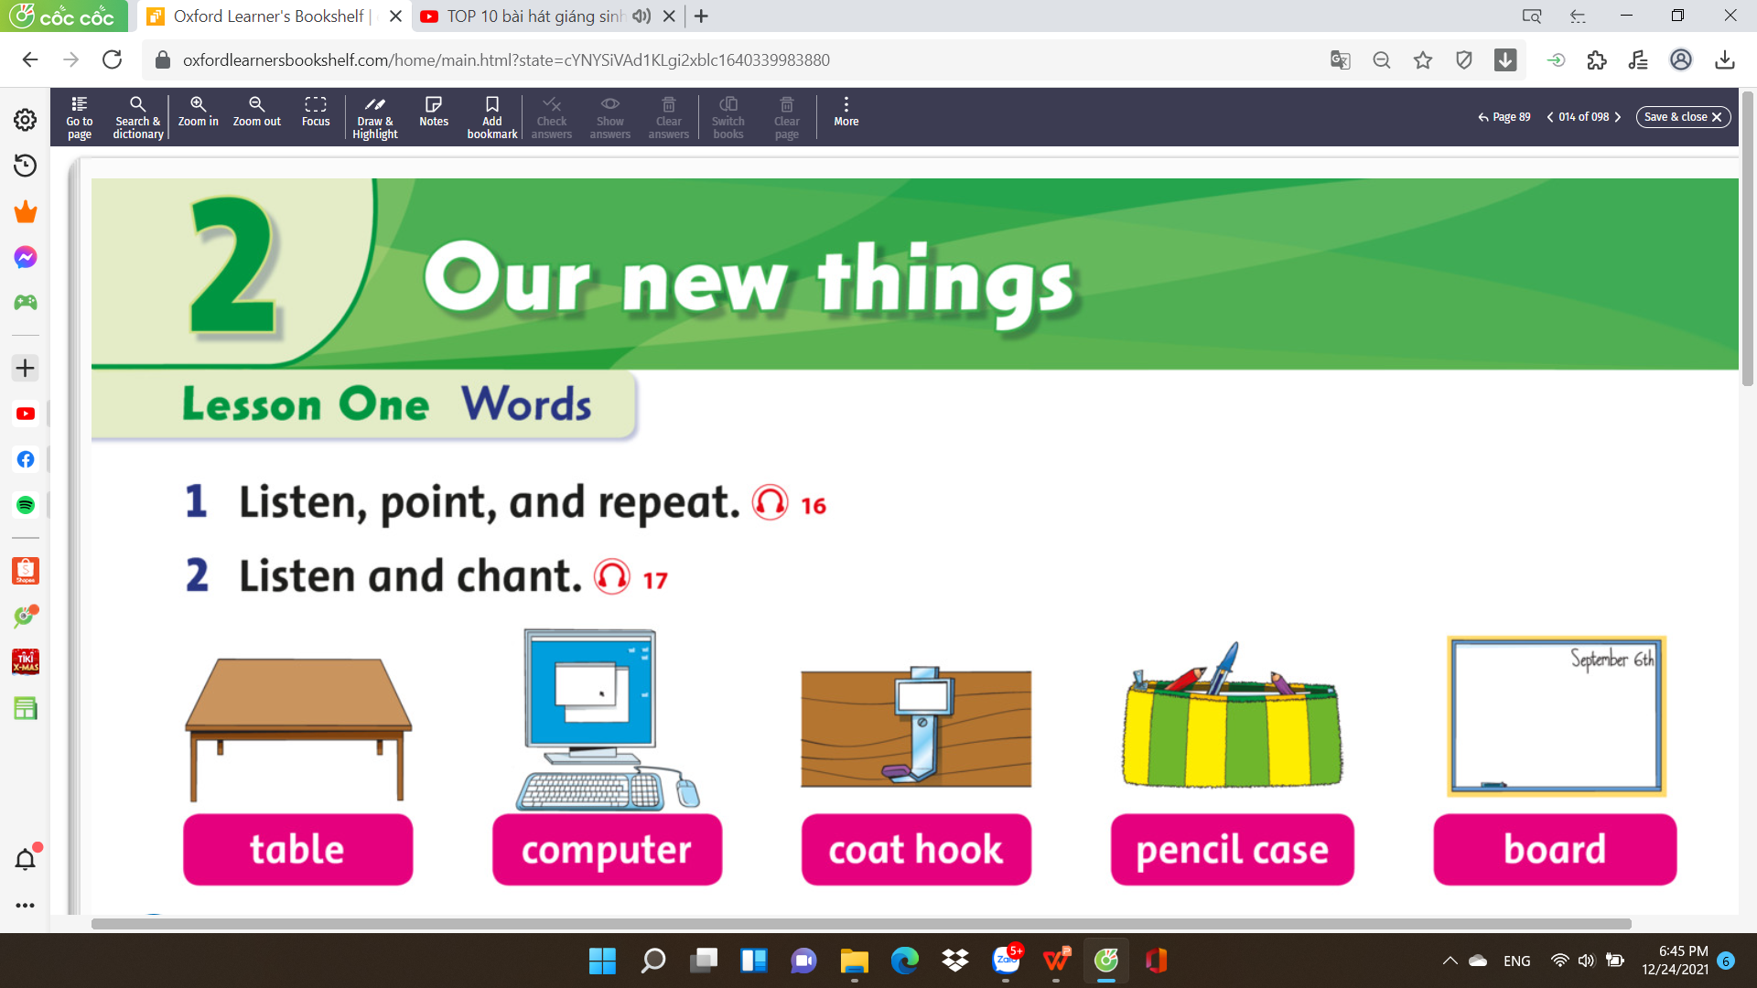

Slide 5
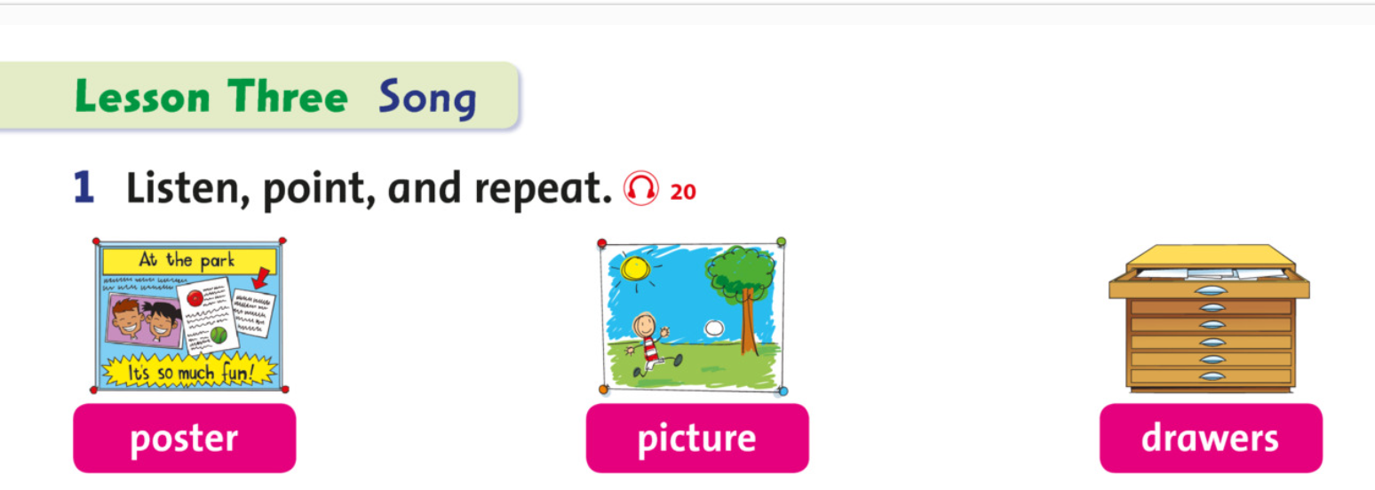

Slide 6
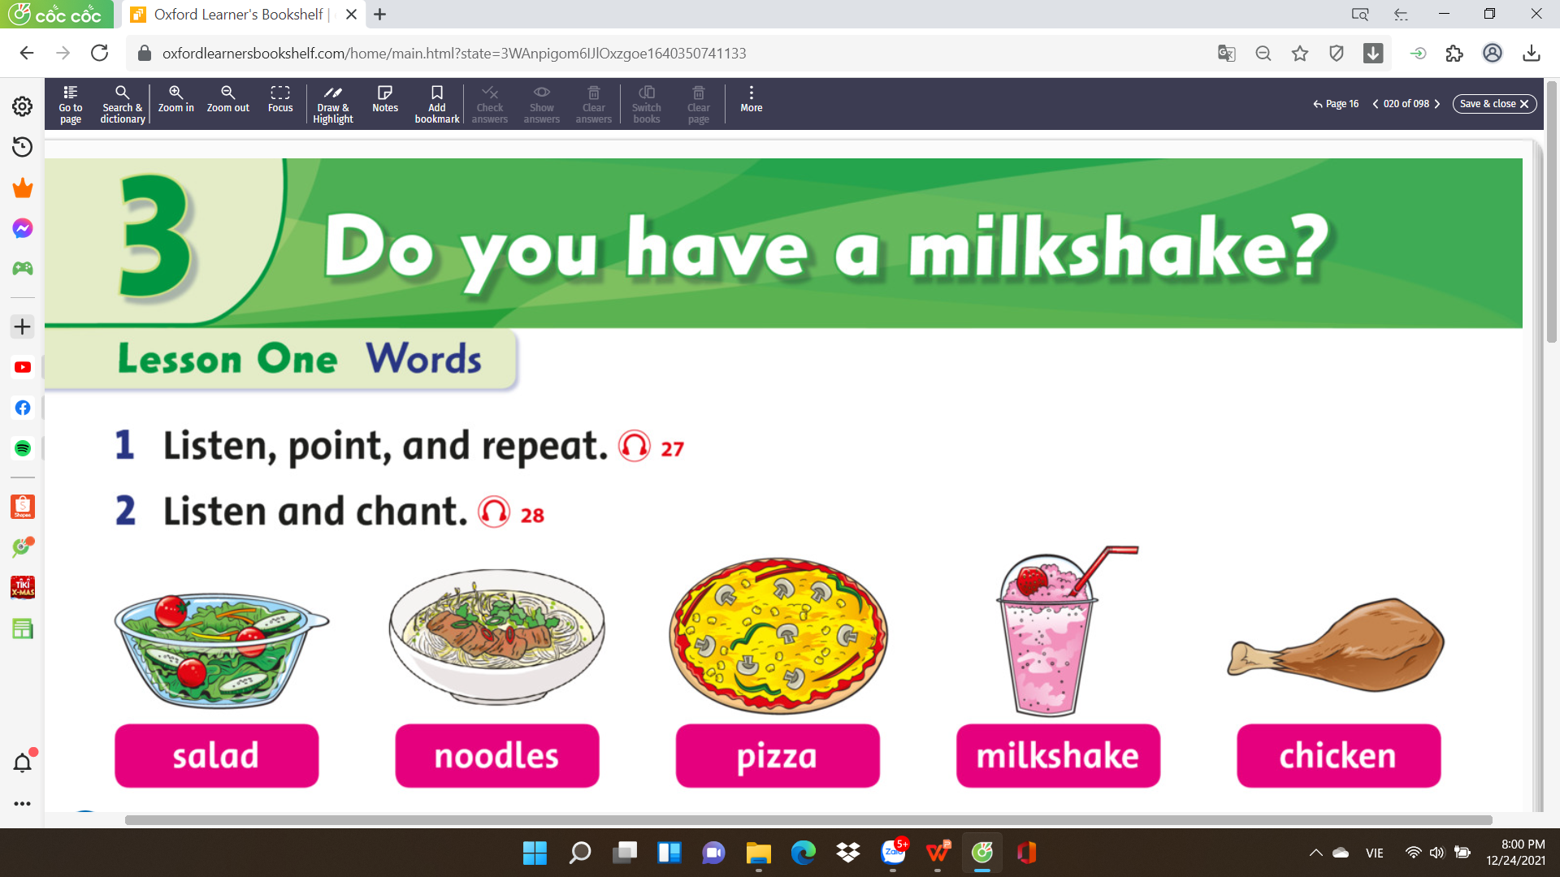

Slide 7
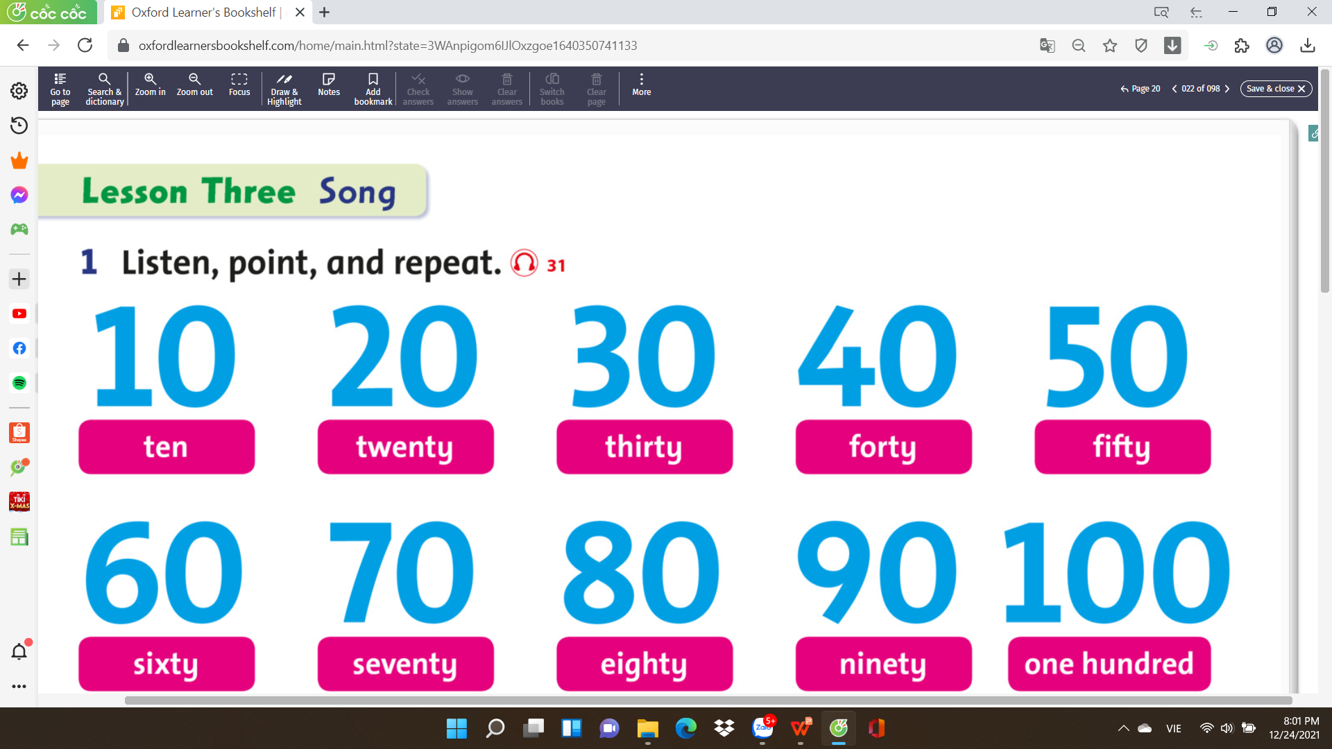

Slide 8
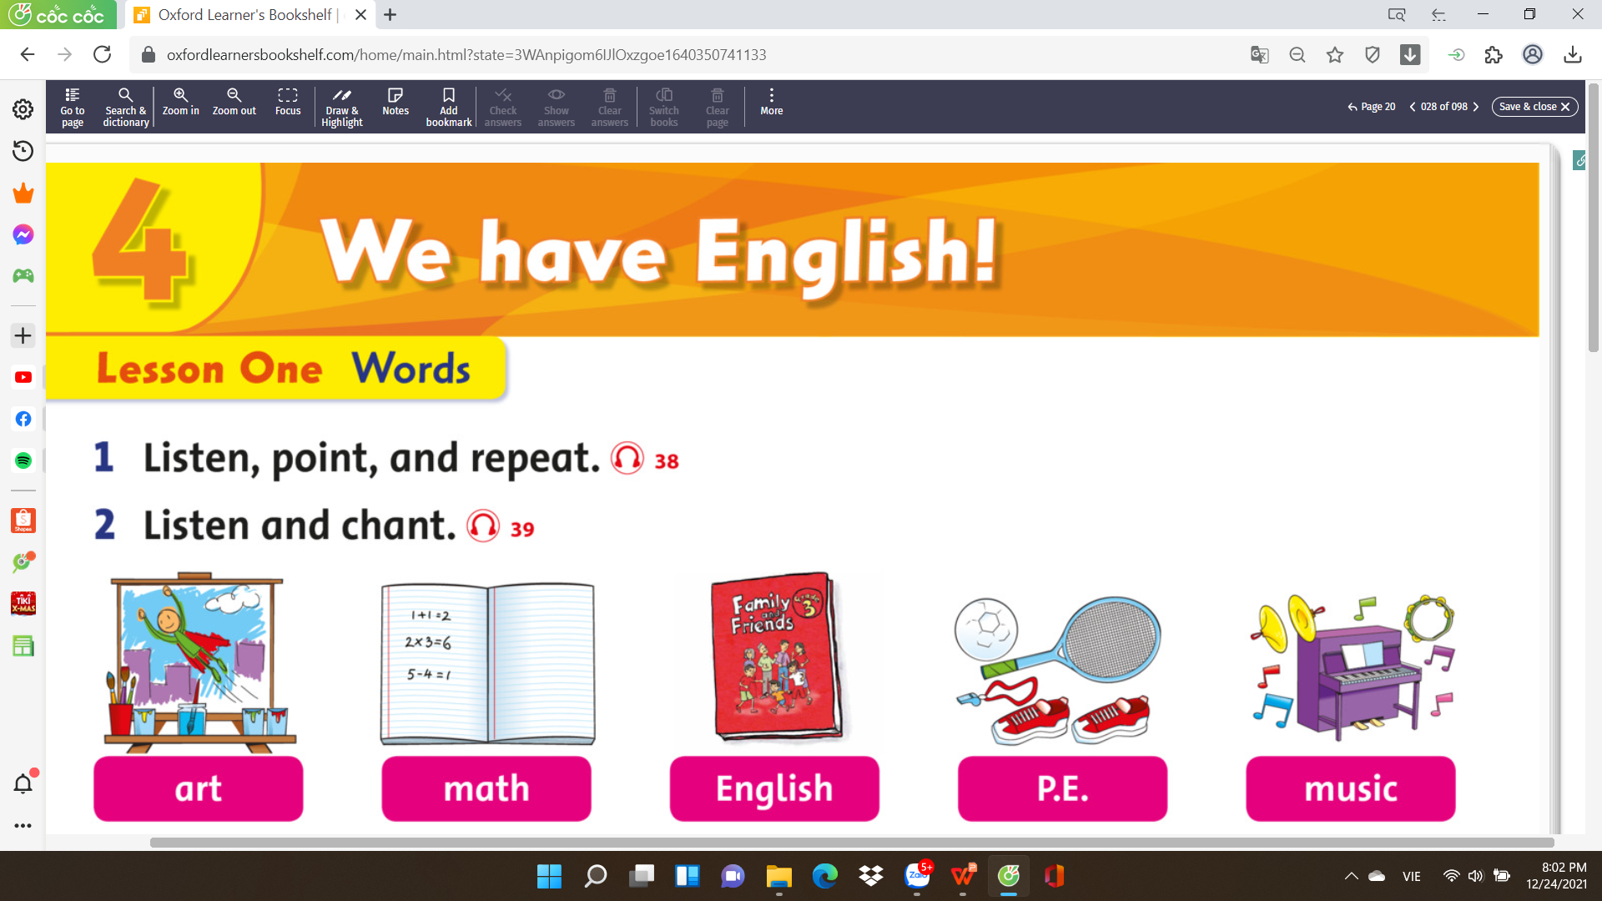

Slide 9
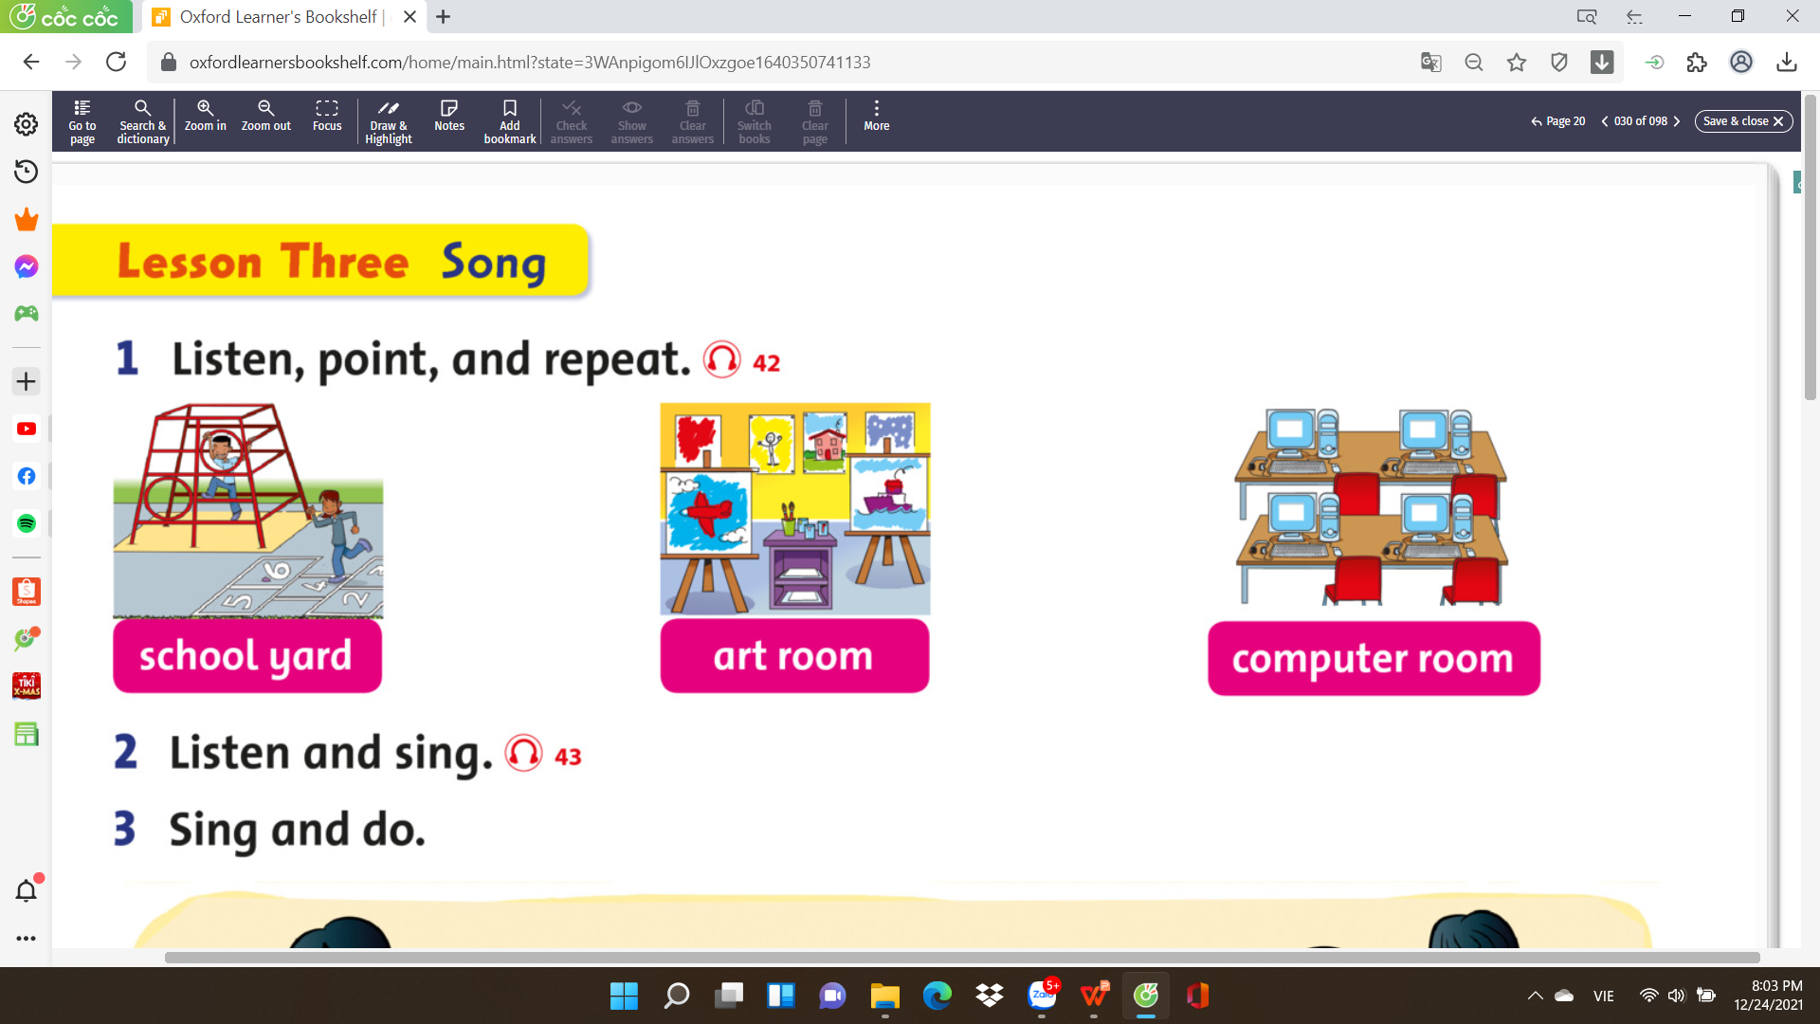

Slide 10
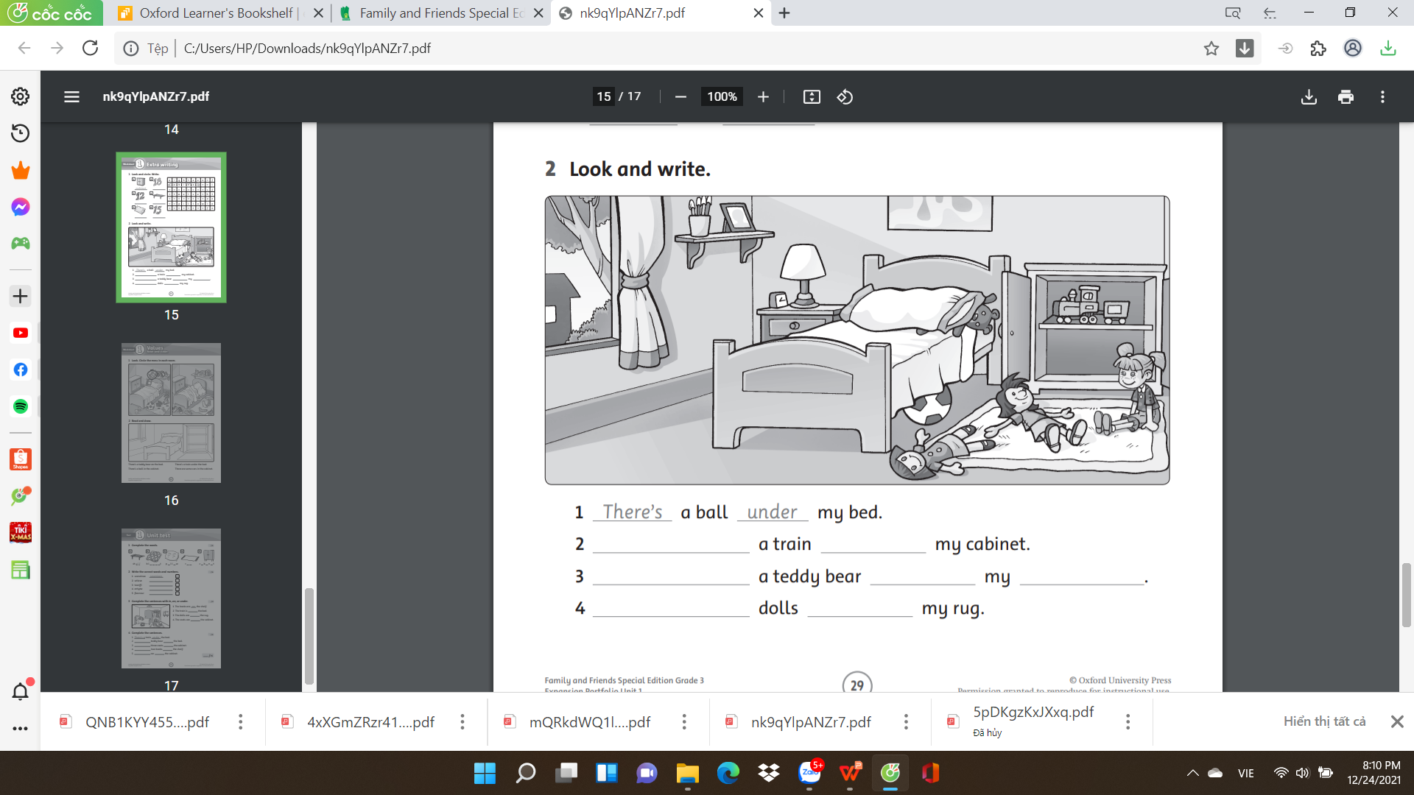
There’s
in
There’s
on
bed
There are
on

Slide 11
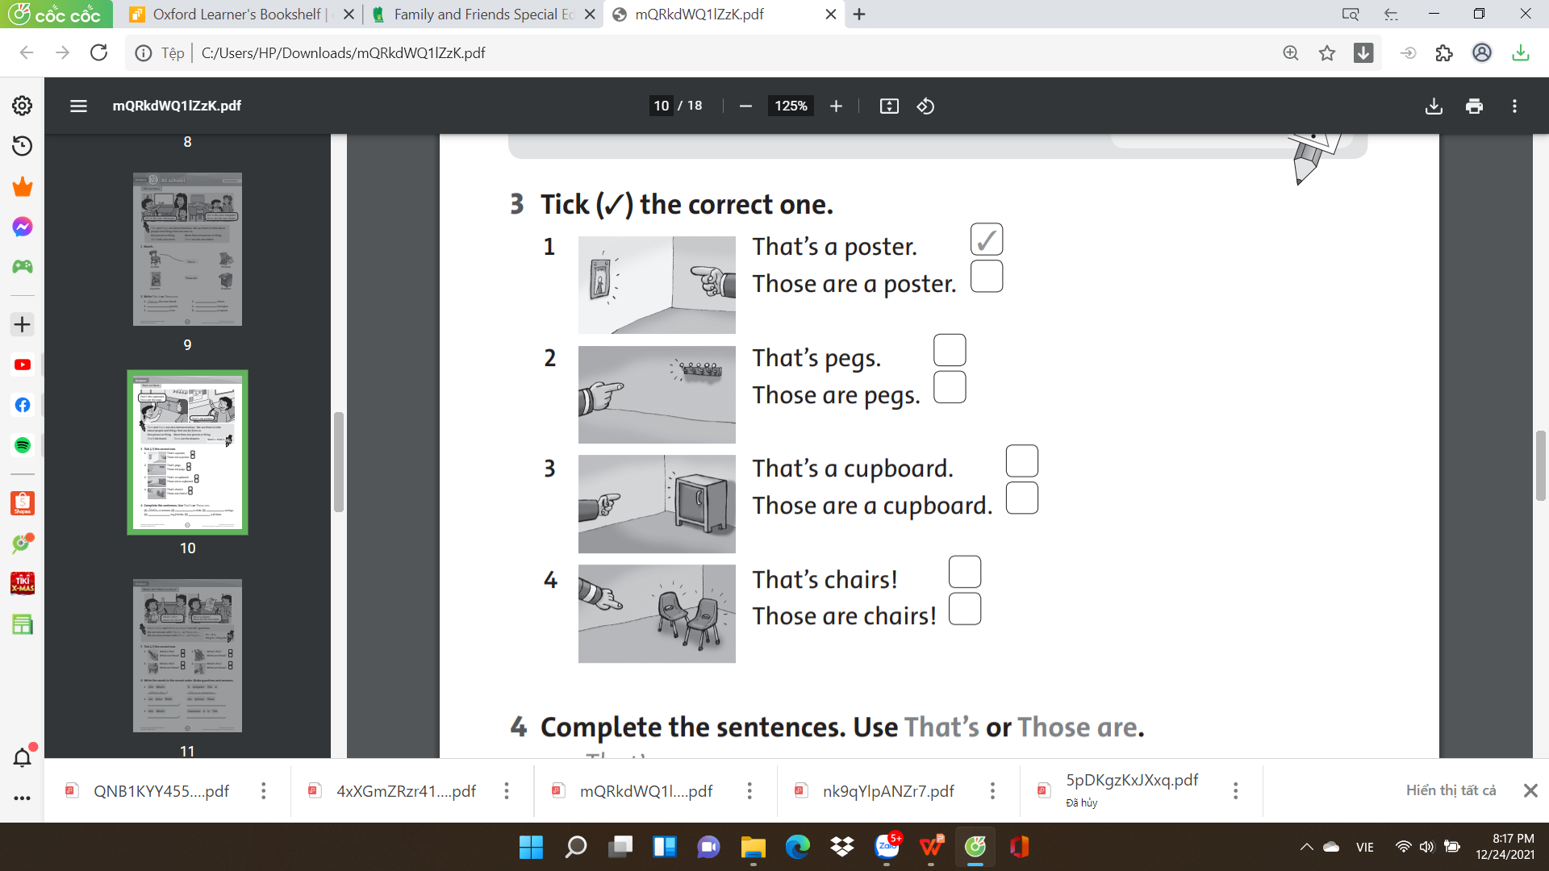
✓
✓
✓

Slide 12
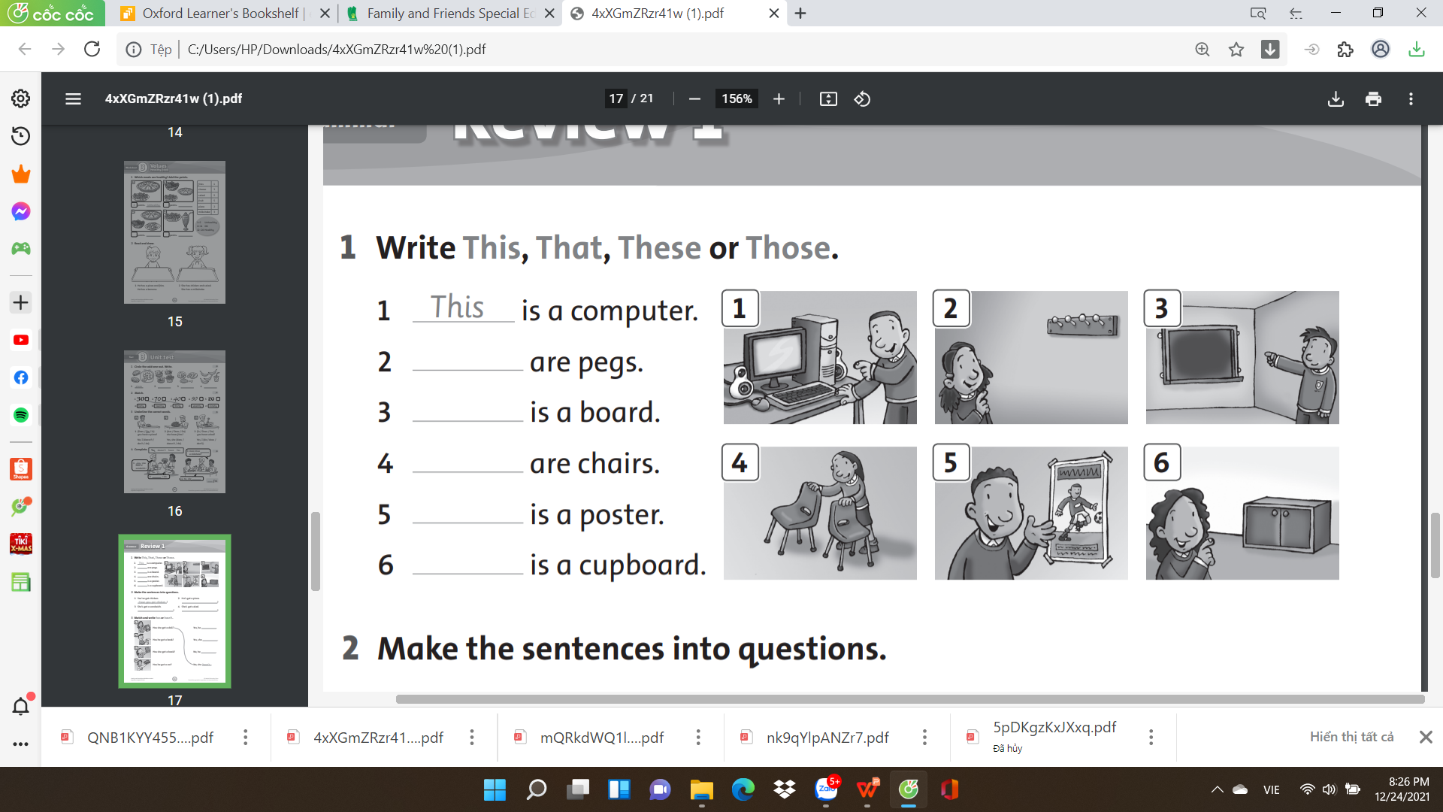
Those
That
These
This
That

Slide 13
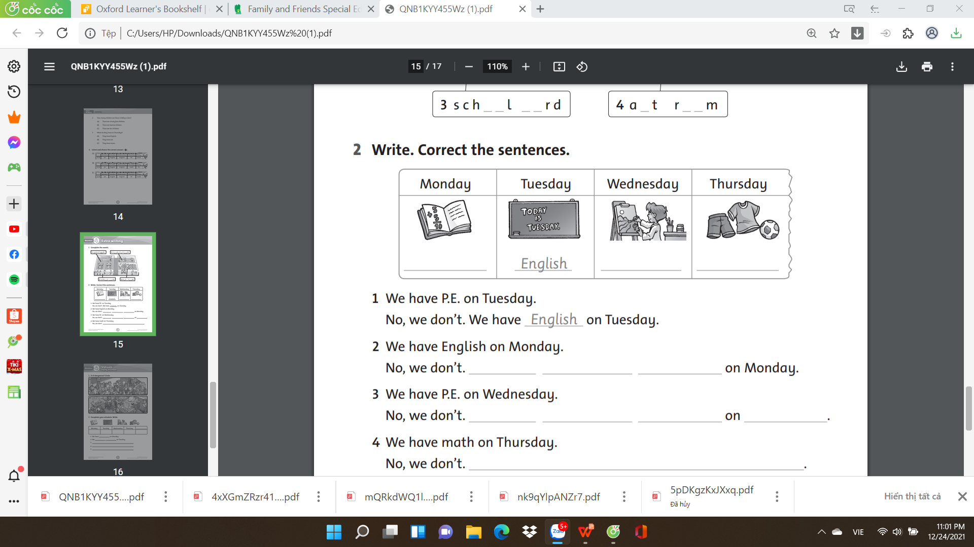
math
art
P.E.
We
We
have
have
math
We
have
art
Wednesday
We
have
art
on
Wednesday

Slide 14

Goodbye~!

